Slide 1

The social dilemma of autonomous vehicles
by Jean-François Bonnefon, Azim Shariff, and Iyad Rahwan
Science
Volume 352(6293):1573-1576
June 24, 2016
Published by AAAS

Slide 2
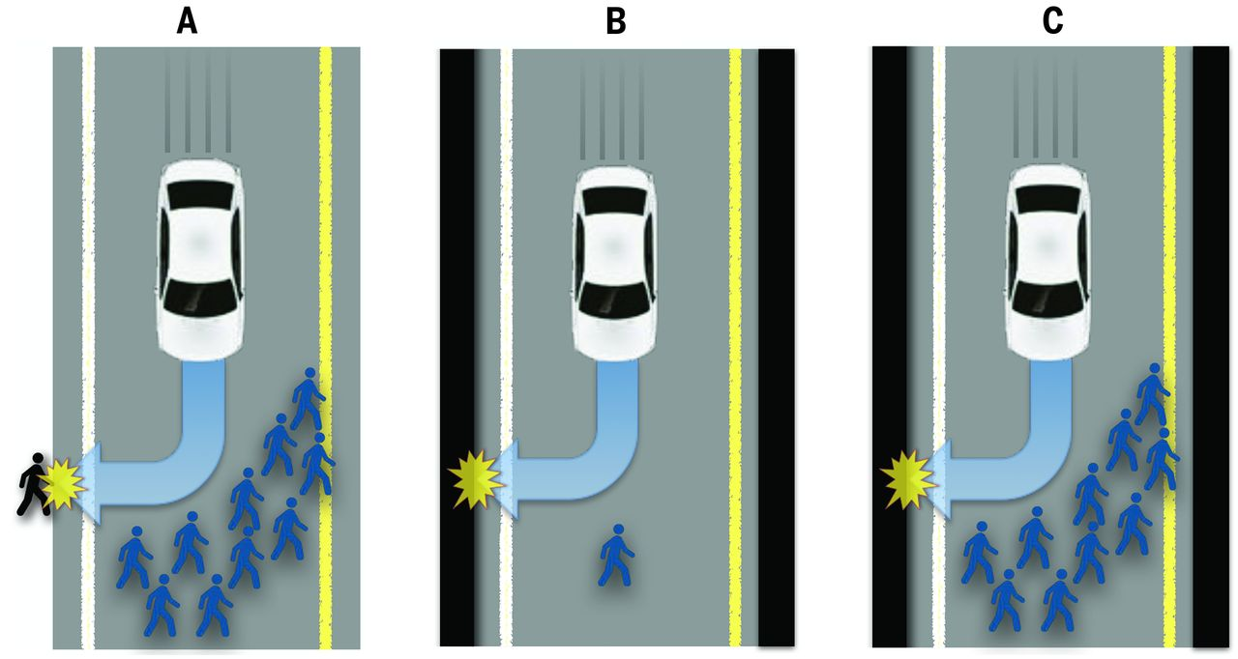
Fig. 1 Three traffic situations involving imminent unavoidable harm.
Jean-François Bonnefon et al. Science 2016;352:1573-1576
Published by AAAS
Notes:
Three traffic situations involving imminent unavoidable harm. The car must decide between (A) killing several pedestrians or one passerby, (B) killing one pedestrian or its own passenger, and (C) killing several pedestrians or its own passenger.

Slide 3
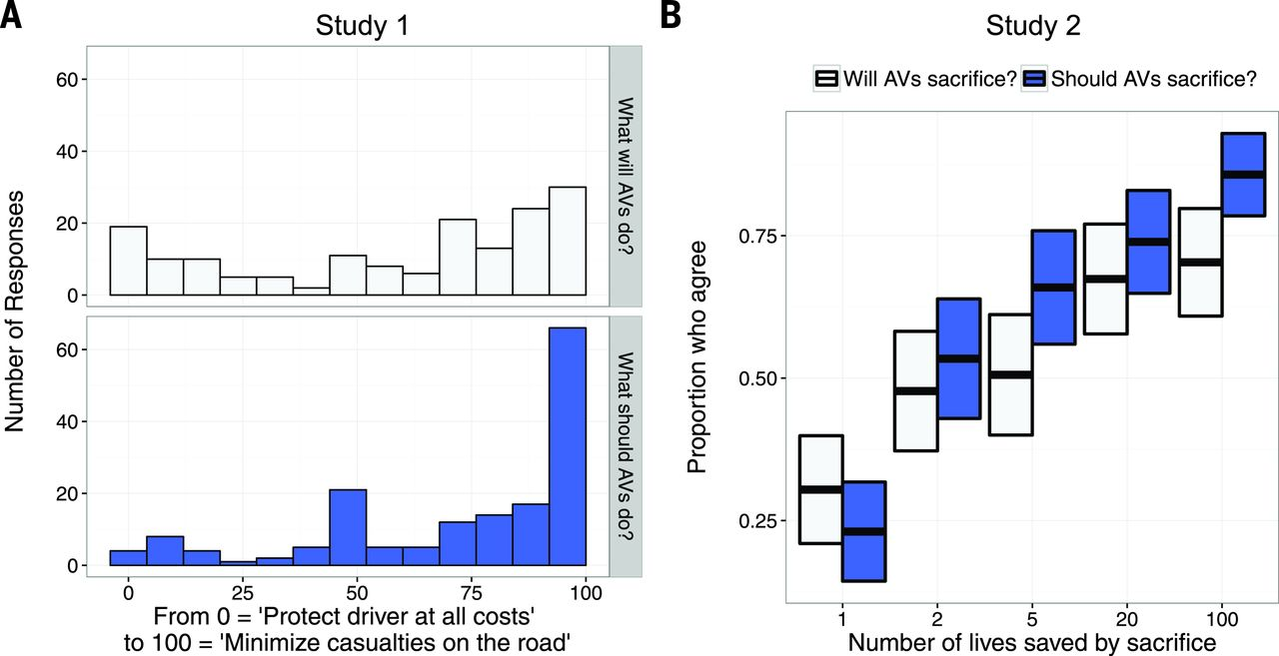
Fig. 2 Considering the greater good versus the life of the passenger.
Jean-François Bonnefon et al. Science 2016;352:1573-1576
Published by AAAS
Notes:
Considering the greater good versus the life of the passenger. (A and B) In studies one and two, when asked which would be the most moral way to program AVs, participants expressed a preference for AVs programmed to kill their passengers for the greater good. This preference was strong, provided that at least five lives could be saved [(A) shows detailed results for 10 lives]. On average, participants were more confident that AVs should pursue the greater good than whether AVs would actually be programmed to do so. In (B), boxes show the 95% CI of the mean.

Slide 4
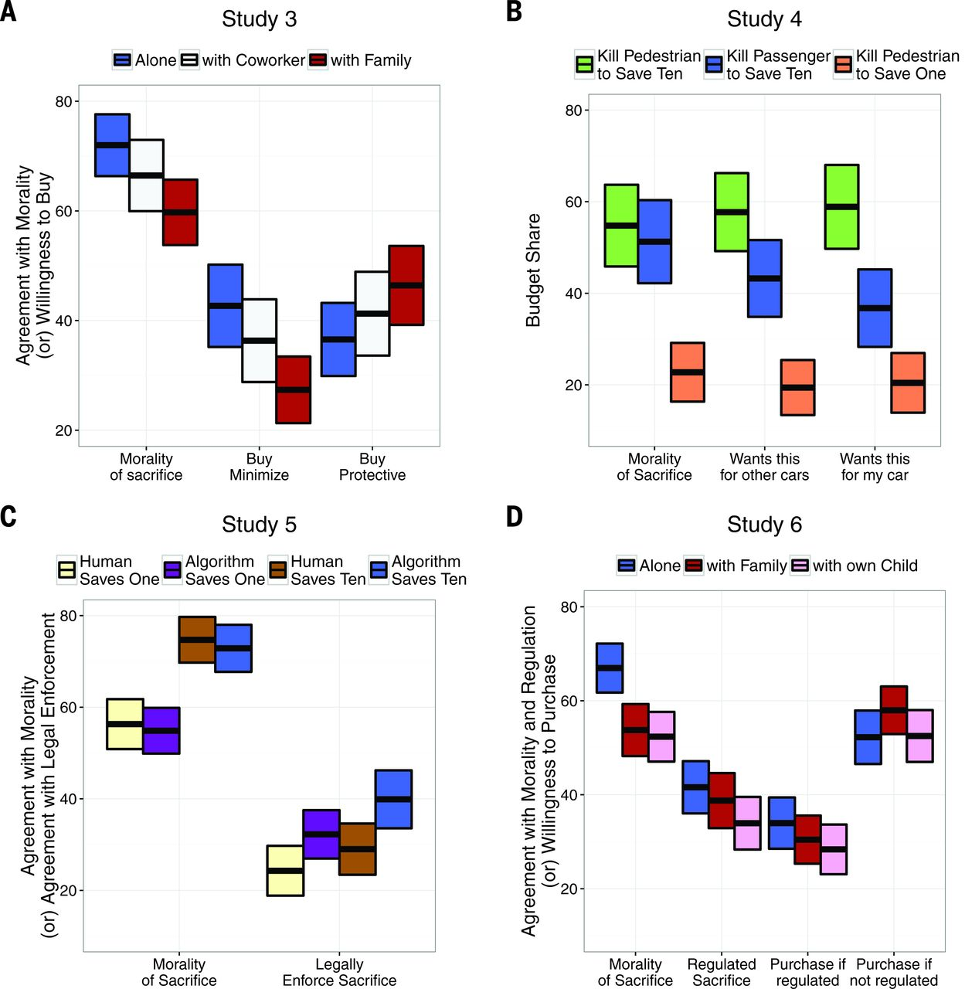
Fig. 3 Toward regulation and purchase (studies three to six).
Jean-François Bonnefon et al. Science 2016;352:1573-1576
Published by AAAS
Notes:
Toward regulation and purchase (studies three to six). (A to D) Boxes show the 95% CI of the mean. In all studies, participants expressed a moral preference for AVs sacrificing their passengers to save a greater number of pedestrians. This moral preference was robust for situations in which participants imagined themselves in the AV in the company of a co-worker, a family member, or their own child. However, participants did not express a comparable preference for buying utilitarian AVs, especially when they thought of family members riding in the car [(A) and (B)]. Additionally, participants disapproved of regulations enforcing utilitarian algorithms for AVs and indicated that they would be less likely to purchase an AV under such regulations [(C) and (D)].

